Slide 1
Electrical Maintenance and its Relationship to Safety
UNIT-IV
V Sem (A & B Sections)

Slide 2
Carbon filament lamp, tungsten lamp, electric toaster, stove,
oven, space heater, or radiant floor, Protective Devices - bimetallic strip, Fuse wires.
Resistor Wattage
Hazard: ARC
Applications
1. Neutral grounding resistors
2. Harmonic filter resistors
3. Snubber resistors
4. Braking resistors used in electric trolleys
5. Starting resistors for DC Motors
6. Load banks for testing generators
Inductors, Reactors, Surge Impedance
The first hazard may be coming in contact with the energized conductors.
Another important hazard is induced currents in conductive materials, which may cause electrical shocks, arcing, and heating.
The effects of the magnetic fields produced by inductance can also affect human health, the most prominent example being biomedical devices such as pacemakers.
Power Capacitors: power factor correction and harmonic filters.
Filter Capacitors: DC power supplies act to reduce the remaining AC components in a pulsating DC voltage after the rectification process is completed.
DC Link capacitors: for AC motor drives act to store energy from the AC system after it has been rectified, in order that the inverter has a constant voltage source.
electrical shock, severe arc flash

Slide 3
UNIT-IV
Safety related case for electrical maintenance – reliability centered maintenance (RCM) – eight step maintenance programme – frequency of maintenance – maintenance equipment for specific equipment and location – regulatory bodies – national electrical safety code – standard for electrical safety in work place – occupational safety and health administration standards.

Slide 4
Safety related case for electrical maintenance
Dust, dirt, and other contaminants collect on equipment, causing the equipment to overheat and bearings and other moving parts to bind.
Vibration causes hardware to loosen. Subsequent operations of equipment can cause joints and equipment to fail explosively.
Heat and age can cause insulation to fail, resulting in shock hazards to personnel.
Increased loads, motor-starting surges, and power quality issues such as harmonics combine to increase the aging process and set the stage for equipment failure.
Electronic components can drift or fail, causing unstable operation of protective equipment.

Slide 5

Relationship of Improperly Maintained Electrical
Equipment to the Hazards of Electricity
Workers may expose to any of the electrical hazards. For example:
Improperly maintained tools or flexible cord sets (extension cords) can have frayed insulation that exposes the energized conductors and allows them to contact the worker or the metallic tool the worker is using. The result is an electric shock.
Improperly maintained protective devices, such as circuit breakers or fuses, can fail when interrupting an over current. Such a failure is likely to be explosive; consequently, the worker is exposed to electrical arc and electrical blast.
Improperly maintained connections can overheat, resulting in any of the following:
  Melted insulation, exposed conductors, and the attendant electrical shock hazard
  Fire
  Failed connections resulting in electrical arc and blast
Improperly maintained switchgear, motor control centers, or panelboards can fail explosively when an arc occurs internally. This exposes workers to the effects of electrical blast and possibly electrical arc.

Slide 6
Reliability centered maintenance (RCM)
Reliability-centered maintenance (RCM) is the process of determining the most effective maintenance approach.
The RCM philosophy employs
preventive maintenance (PM),
predictive maintenance (PdM),
real-time monitoring (RTM),
run-to-failure (RTF; also called reactive maintenance),
and proactive maintenance techniques
in an integrated manner to increase the probability that a machine or component will function in the required manner over its design life cycle with a minimum of maintenance.
The goal of the philosophy is to provide the stated function of the facility, with the required reliability and availability at the lowest cost.

Slide 7
Function Oriented
Preserve system or equipment function
Redundancy of function through multiple equipment
System Focused
Maintaining system function
Not individual component function
Reliability Centered
It treats failure statistics
conditional probability of failure at specific ages
improves functional reliability but increases life-cycle cost
Acknowledges Design Limitations
changes in inherent reliability are the province of design rather than maintenance
Driven by Safety and Economics
Safety
Failure as Any Unsatisfactory Condition
loss of function
Economic cost
loss of acceptable quality
Logic Tree to Screen Maintenance Tasks
a consistent approach to the maintenance of all kinds of equipment

Slide 8
RCM Structure
Reliability Centered Maintenance (RCM)
Preventive Maintenance (PM)
Run to Failure (RTF)
Condition based Maintenance
(CBM)
Predictive Maintenance (PdM)
Real Time Monitoring
(RTM)

Slide 9
Will failure of the facility or equipment have a direct adverse effect on safety related critical operations
NO
YES
Is the item expendable?
Can redesign solve the problem permanently and be cost effective?
NO
YES
YES
Is there a PdM or real-time monitoring technology that will give sufficient warning of an impending failure?
NO
Redesign
NO
YES
Is there an effective PM Task that will minimize failures?
Is the Test/Monitoring cost Justified?
NO
YES
YES
Is redesign cost and priority Justified?
NO
YES
Redesign
Define PM Task
Redesign
Accept Risk

Slide 10
RCM analysis
What does the system or equipment do; what is its function?
What functional failures are likely to occur?
What are the likely consequences of these functional failures?
What can be done to reduce the probability of the failure, identify the onset of failure, or reduce the consequences of the failure?

Slide 11
Specific RCM objectives
To ensure realization of the inherent safety and reliability levels of the equipment.
To restore the equipment to these inherent levels when deterioration occurs.
To obtain the information necessary for design improvement of those items whose inherent reliability proves to be inadequate.
To accomplish these goals at a minimum total cost, including maintenance costs, support costs, and economic consequences of operational failures.

Slide 12
Maintenance Actions in an RCM
Failure: Failure can be defined in many ways. In a broad sense, failure is simply an unsatisfactory condition.
Functional Failure: A functional failure is essentially the inability of an item or system to meet its specified performance standard. A complete loss of function is a functional failure.
Consequences of Failure: The consequences of failure determine the priority of maintenance activities or design improvement required to prevent occurrence.

Slide 13
Outcomes from an RCM analysis
Perform No Maintenance
Perform Preventive Maintenance (PM)
PM consists of regularly scheduled inspections, adjustments, cleanings, lubrication, and replacement of components and equipment. PM is also referred to as time-driven or interval based maintenance. It is performed without regard to equipment condition.
Perform Condition-Based Maintenance (CBM)
CBM consists of
Predictive maintenance (PdM)
Real-time monitoring.
PdM primarily uses nonintrusivee testing techniques to measure and trend equipment performance. Real-time monitoring uses current performance data to asses machinery condition.

Slide 14
Condition-Based Maintenance
CBM replaces arbitrarily timed maintenance tasks with maintenance that is scheduled only when warranted by equipment condition.
Continuing analysis of equipment condition data allows for planning and scheduling maintenance activities or repairs prior to functional or catastrophic failure.
When failure of a system or piece of equipment is an unacceptable risk and none of the above tasks can help mitigate the failure, a redesign of the equipment or system is in order.
Adding redundancy eliminates the risk and adds very little to overall maintenance costs.

Slide 15
Impact of RCM on a Facilities Life Cycle
Reliability-centered maintenance is the process of determining the most effective maintenance approach.
As the airline industry showed 40 years ago, RCM can not only improve the reliability of a system, it can significantly reduce the required maintenance.

Slide 16
Life-cycle phases of Equipment
A facilities life cycle is often divided into two broad stages: acquisition (planning, design, and construction) and operations. RCM affects all phases of the acquisition and operations stages to some degree.
Properly implemented RCM program reduced failures and reduced work.

Slide 17
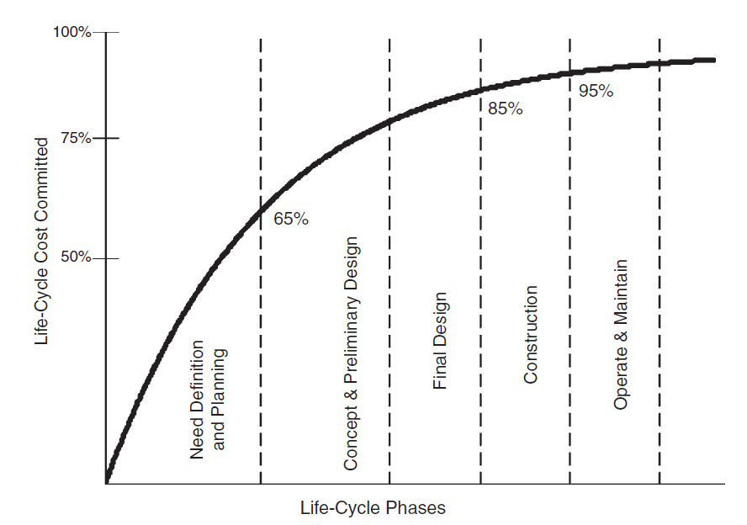

Slide 18
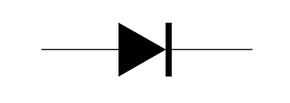
Resistor
Diode
Motor Load
V

Slide 19
Eight step maintenance programme
Steps are plan, inspect, clean, tighten, lubricate, test, record, and evaluate.
Step-1 Plan: Before working on anything, take time to think about what you are going to do and how you are going to do it. A few minutes of thought before the job is started results in a safer and more efficient job. This step is especially important when you are performing emergency repair work.
Start by identifying the specific task or tasks that you intend to perform. In this initial stage, you do not need to go into too much detail; rather, concentrate on the broad goals that you need to accomplish. List each goal, the personnel that you will use, the equipment that you will need, and the amount of time that will be required.

Slide 20
Step 2—Inspect
Periodic inspections should be set up on a routine basis. Inspection can be done with the senses that nature gave us, called unaided inspection, or with instruments such as infrared viewers, ultrasound transducers, and so on.
Unaided Inspection
Inspection with Tools or Instruments.
Step 3—Clean
Dirt and electricity don’t mix. After you have completed the inspection of your electrical equipment, the next step is to clean all components.
The first step is general cleanliness. Dust, dirt, and foreign material must be cleaned from motors, switchgear, transformers, and other such electrical equipment.

Slide 21
Step 4—Tighten
Tightening fasteners on electrical equipment takes special care and should be done to the torque recommended by the equipment manufacturer. Electrical connections are especially critical.
Recommended torque values can be found in the maintenance and acceptance testing specifications published. Be certain to torque connections per this table and/or the manufacturer’s recommendations.
Step 5—Lubricate – Non-conductors and conductors
Step 6—Test
Electrical equipment should be tested periodically. Insulation resistance should be measured, breaker trip times should be checked, relays should be calibrated, and a variety of other procedures should be performed. The only exercise that many protective devices get is during the test interval.

Slide 22
Step 7—Record
Doing work without keeping records is almost useless. Recording test and other data can help set maintenance intervals, isolate troublesome equipment (or manufacturers), and provide a baseline that helps to indicate when insulation or other components are starting to fail.
Besides test results, records should always include the date, equipment identification, and all pertinent data on any problems discovered. System conditions like load current, voltage, temperature, and other such information can help determine how close components are to being overloaded.
Step 8—Evaluate
Analysis of records allows the company to determine what, if any, additional maintenance needs to be performed and to pinpoint problems that might otherwise go unobserved.

Slide 23
Frequency of maintenance
Determining Testing Intervals
Start initially with a once-per-year test program. Continue this procedure for the first two intervals.
Review the test records from your maintenance intervals.
If frequent and/or severe problems are evident, decrease the maintenance intervals.
If no major or frequent problems are evident, increase the maintenance intervals.
Repeat steps 2 through 5 throughout the life of your maintenance program.

Slide 24
Condition-Based Maintenance (CBM)
Condition-based maintenance (CBM) is one of the key building blocks in a reliability-centered maintenance (RCM) program.
In a CBM environment, maintenance efforts and expenditures are based on the actual condition of the maintained equipment; that is, equipment that is consistently in good to superior condition does not need to be maintained as frequently as equipment that is deteriorating or has reached an age where deterioration is anticipated.
The use of test or running data to statistically model and predict the future condition of the equipment is at the very heart of CBM.

Slide 25
Real-Time Monitoring (RTM) provides a continuous stream of data from operating equipment.
For example, rotating-equipment, RTM systems provide continuous monitoring of speed, vibration, voltage, current, and frequency data. Careful analysis of the collected data allows the user to diagnose incipient faults.
RTM is being used widely on motors, generators, and transformers.
Predictive Maintenance (PdM) In its simplest form, PdM uses test results taken from PM procedures. These results are statistically evaluated and a prognosis is developed allowing the system operators to increase, decrease, or even eliminate maintenance intervals

Slide 26
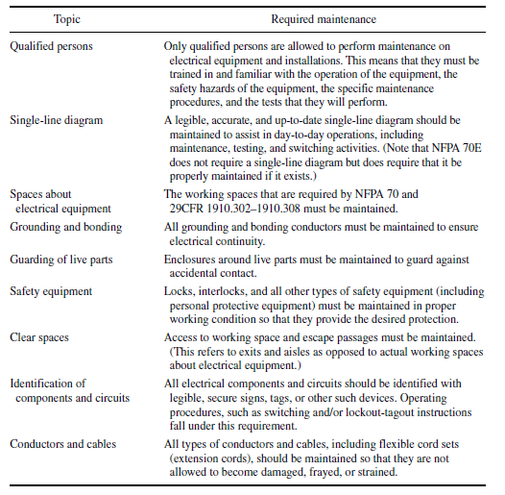
Maintenance Requirements for specific equipment and location

Slide 27
General Maintenance Requirements
Substations, Switchgear, Panel boards, Motor Control Centers, and Disconnect Switches Enclosures (Electrical Rooms, Buildings, and Other Such Locations).
Enclosures must be kept clear of extraneous materials that could cause a tripping, fire, or any other type of hazard.
Area Enclosures (Fences and Other Such Enclosures).
Fences and other such guards shall be maintained to prevent unauthorized access or accidental exposure to electrical hazards. This requirement is especially important for fences that protect the public from access to electrical facilities.
Conductors. All current-carrying conductors must be maintained so that they can carry rated current without overheating. They must also be maintained so they can carry available short-circuit current without failing and introducing arc and blast hazards.
Electrical Insulation, Protective Devices, Fuse Maintenance, Low voltage, Medium voltage Circuit Breakers

Slide 28
Regulatory bodies
  International Electrotechnical Commission (IEC)
  American National Standards Institute (ANSI )
  Institute of Electrical and Electronics Engineers (IEEE )
  National Fire Protection Association (NFPA)
  American Society for Testing and Materials (ASTM )
  American Society of Safety Engineers (ASSE )
  Occupational Safety and Health Administration (OS HA)

Slide 29
National electrical safety code
The code has three general rules as follows:
All electric supply and communication lines and equipment shall be designed, constructed, operated, and maintained to meet its requirements.
The utilities, authorized contractors, or other entities, as applicable, performing design, construction, operation, or maintenance tasks for electric supply or communication lines or equipment covered by the NESC are held responsible for meeting the applicable requirements.
For all particulars not specified in the NESC, construction and maintenance should be done in accordance with accepted good practice for the given local conditions.

Slide 30
NEC Include...
The principal objective of the NEC is to provide standardized, technically sound electrical installation standards to help minimize the possibility of electric fires.
The NEC covers four basic types of installations. Note that all of these installations are so-called utilization installations as opposed to transmission and distribution.
Installations of electric conductors and equipment within or on public and private buildings or other structures, including mobile homes, recreational vehicles, and floating buildings.
This section also includes premises wiring for such facilities as yards, carnival lots, parking lots, and industrial substations.
Installations of conductors and equipment that connect to the supply of electricity.
Installations of other outside conductors and equipment on the premises.
Installations of optical fiber cable.

Slide 31
Technical and Safety Items Covered
The Code has multiple chapters that include rules for wiring and protection, wiring methods and materials, equipment for general use, special occupancies, special equipment, special conditions, and communications systems.
Tables for conductor ampacities are included along with formulas for calculating the required size and number of conductors for special applications, as well as sizing requirements for protective devices.
Grounding requirements including what, when, and how are included. Rules for interrupting capacities and other such information are also included.
The NEC has become an engineering reference, an installation guide, a design standard, and a fire safety code all in one volume.

Slide 32
NEC does not apply to...
The NEC also lists several installations to which it does not apply including ships, railway rolling stock, underground mine installations, railway generation, communications equipment under the control of communications utilities, and certain facilities under the control of electric utilities.
The utility facilities that are excluded are the communications, metering, generation, transformation, transmission, and distribution in buildings or substations used specifically for that purpose.
The NEC does include utility office buildings and other such public and commercial structures.

Slide 33
Electrical Equipment Maintenance (70B)
In studying the need for this document, the committee determined that electrical safety concerns logically fall into four basic categories: product design standards, installation standards (covered by the NEC and the NESC), safety-related maintenance information (covered by NFPA 70E, Chapter 2 and NFPA 70B), and usage instructions.
Because of the high number of injuries and deaths related to improper or nonexistent equipment maintenance practices, the committee decided that an electric equipment maintenance document should be developed.
NFPA 70B, contains recommended practice information for proper maintenance of electric equipment.

Slide 34
Industries and Facilities Covered
Document 70B covers maintenance of industrial-type electric systems and equipment. The covered systems and equipment are typical of those installed in commercial buildings, industrial plants, and large multifamily dwellings.
Document 70B specifically states that it does not cover consumer appliances or home-type equipment. It also states that it is not intended to supersede manufacturer-recommended maintenance procedures.
Also Technical and Safety Items are Covered

Slide 35
The National Electrical Safety Code (NESC) by IEEE
It is intended to provide practical rules for safeguarding personnel during the installation, operation, or maintenance of electric supply and communications lines and associated equipment.
The code has three general rules as follows:
All electric supply and communication lines and equipment shall be designed, constructed, operated, and maintained to meet its requirements.
The utilities, authorized contractors, or other entities, as applicable, performing design, construction, operation, or maintenance tasks for electric supply or communication lines or equipment covered by the NESC are held responsible for meeting the applicable requirements.
For all particulars not specified in the NESC, construction and maintenance should be done in accordance with accepted good practice for the given local conditions.

Slide 36
Industries and Facilities Covered
The NESC rules cover supply and communication lines, equipment, and associated work practices used by both public and private electric supply, communications, railway, or similar utilities. The rules also cover similar systems that are under the control of qualified persons.
This means that facilities such as cogeneration plants, industrial complexes, or utility interactive systems are covered by the NESC.
Note that the NESC specifically states it does not cover installations in mines, ships, railway rolling equipment, aircraft, automotive equipment, or utilization wiring except in certain cases. It also specifies that building utilization requirements are covered by the National Electrical Code

Slide 37
Standard for electrical safety in work place

